Slide 1
Real-Time GW-BSE Investigation on Spin-Valley Exciton Dynamics
Jin Zhao
University of Science and Technology, China (USTC)
VISTA Seminor
Seminor 25
10/14/2021

Slide 2
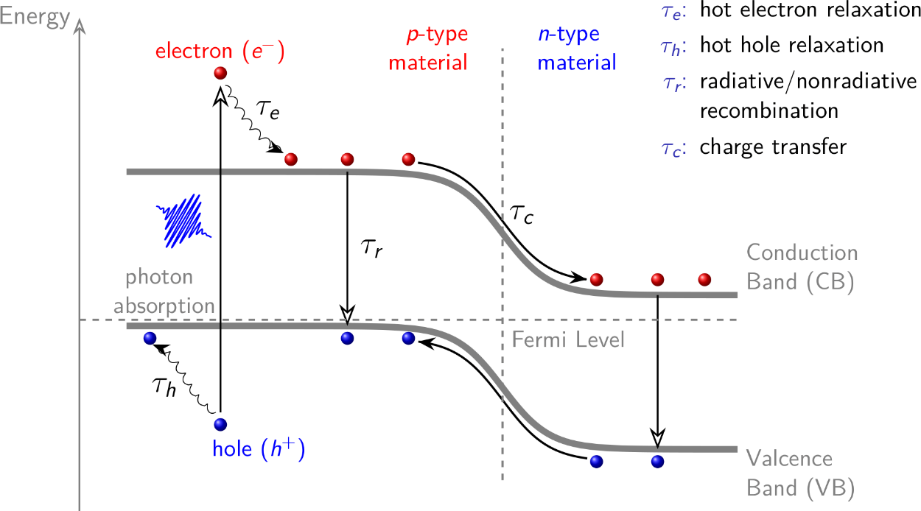
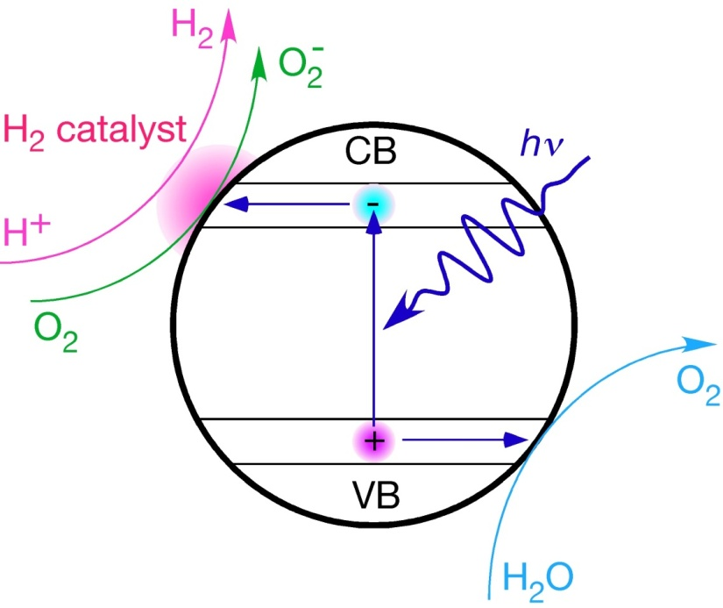
Excited Carrier Dynamics in Solar Energy Conversion
Photovoltaics
Photocatalysis
hot carrier relaxation
electron-hole recombination
interfacial charge transfer

Slide 3
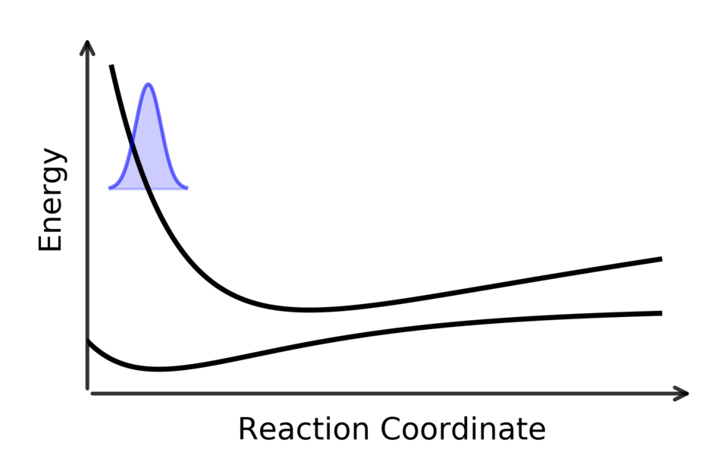
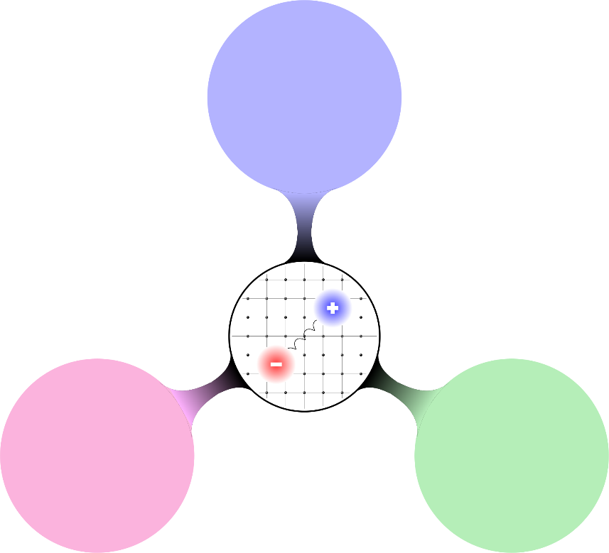
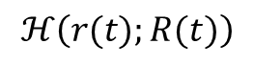
Challenges for Ab Initio Calculations
e-h interaction
$$ℋ\left(r(t);R(t)\right)$$
e-ph coupling
Spin-orbital Coupling
Time-dependent dynamics
Nonadiabatic effects
Different interactions

Slide 4
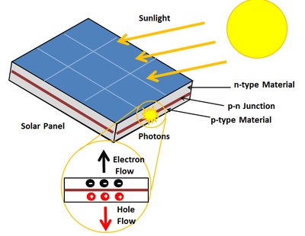
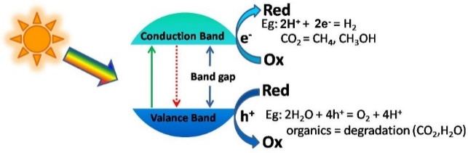
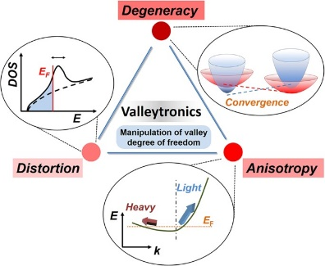
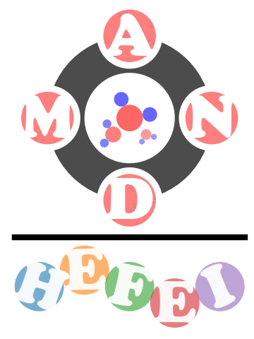
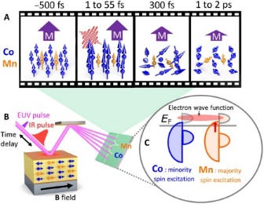
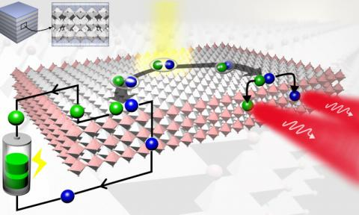
Hefei – Nonadiabatic Molecular Dynamics
(Hefei-NAMD)
Photovoltaics
Single Particle Dynamics
Photocatalysis
valleytronics
Spin Dynamics
Exciton dynamics
Spintronics
optoelectronics
http://staff.ustc.edu.cn/~zhaojin/code.html

Slide 5
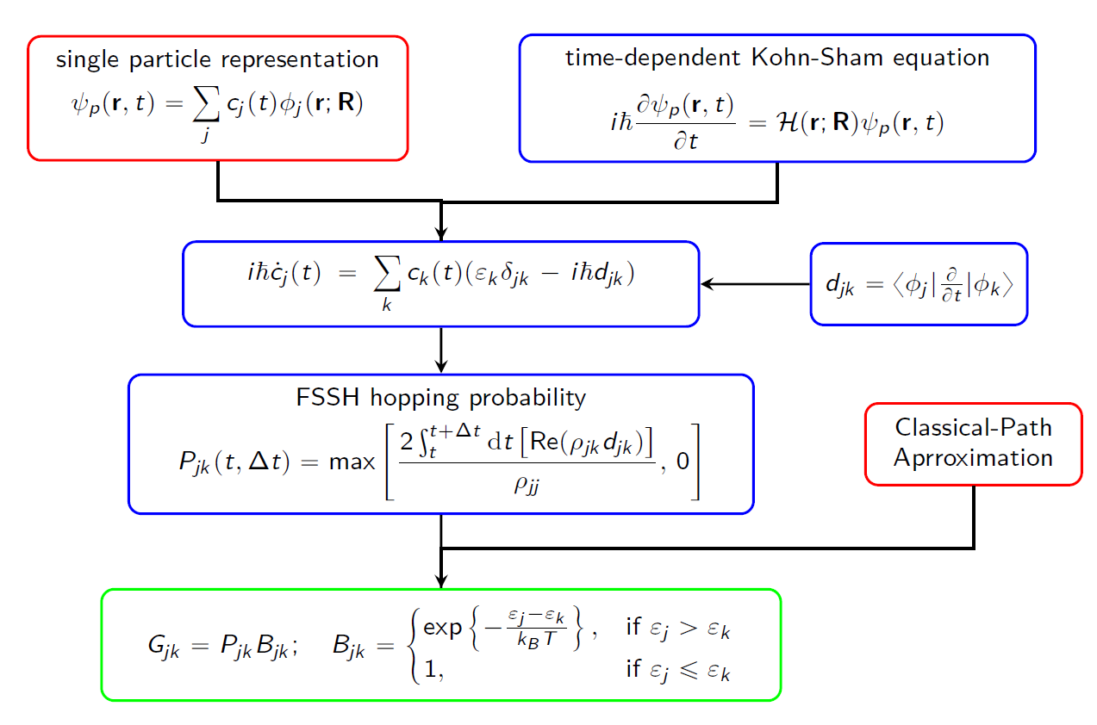
Surface Hopping Combined with TDKS
Nonadiabatic coupling (NAC)
A. Akimov and O. Prezhdo: Pyxaid
Q. Zheng, X. Jiang, et. al. J. Zhao: Hefei-NAMD

Slide 6
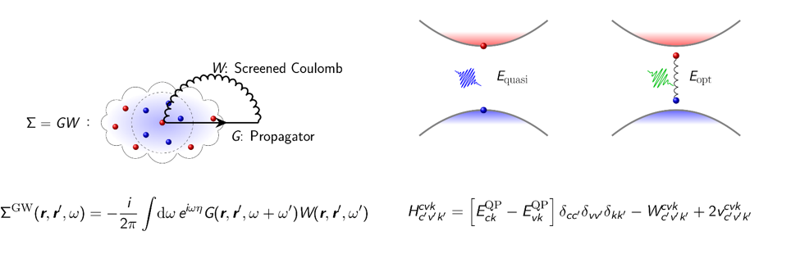
GW + BSE to Describe the Exciton
Bethe-Salpeter Equation (BSE): Screened Coulomb (W) and exchange (v) interaction of electron and hole
Exciton binding energy and wave function
GW: self-energy take place of exchange correlation potential
Accurate Quasi-particle energies

Slide 7
Exciton Dynamics is Important
Exciton dynamics:
Exciton relaxation
Bright-to-dark transition
Single-to-multi transition
Singlet fission
Exciton annihilation (radiative and nonradiative)
…
10,000 times of GW+BSE calculations are too expensive!

Slide 8
Realization of GW + Real-Time BSE
From GW
BSE Hamiltonian:
Coulomb Interaction:
Exchange Interaction:
from time-dependent Kohn-Sham basis sets
Rigid dielectric function during MD
10,000 real-time GW + BSE – 1 GW + real-time BSE
QP energy: Rigid shift from KS energy

Slide 9
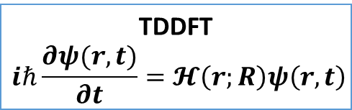
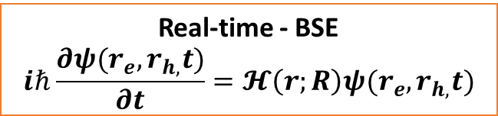
Diabatic Representation
Single-particle
TDDFT
$$iℏ\frac{∂ψ(r,t)}{∂t}=𝓗\left(r;R\right)ψ\left(r,t\right)$$
Real-time - BSE
$$iℏ\frac{∂ψ(r_{e},r_{h,}t)}{∂t}=𝓗\left(r;R\right)ψ(r_{e},r_{h,}t)$$
two-particle

Slide 10
Adiabatic Representation
Diagonalize the BSE Hamiltonian to get the exciton basis sets

Slide 11

$$H_{ki}=ε_{k}δ_{ik}−iℏ\left\langle k | \frac{∂}{∂t} | i\right\rangle$$
Single particle
Exciton-phonon interaction
Non-adiabatic coupling for exciton

Slide 12
Exciton with Spin

Slide 13
Exciton dynamics with SOC
Screened coulomb interaciton
Exchange interaction

Slide 14
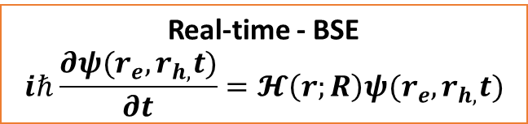

Realization of GW + Real-Time BSE
Single-particle
TDDFT
$$iℏ\frac{∂ψ(r,t)}{∂t}=𝓗\left(r;R\right)ψ\left(r,t\right)$$
Real-time - BSE
$$iℏ\frac{∂ψ(r_{e},r_{h,}t)}{∂t}=𝓗\left(r;R\right)ψ(r_{e},r_{h,}t)$$
Spin orbital coupling
two-particle
Many-body interaction：Coulomb and exchange
Exciton-phonon interaction：real-time BSE + molecular dynamics
Spin orbital coupling：adiabatic and diabatic representation
Nonadiabatic: surface hopping

Slide 15
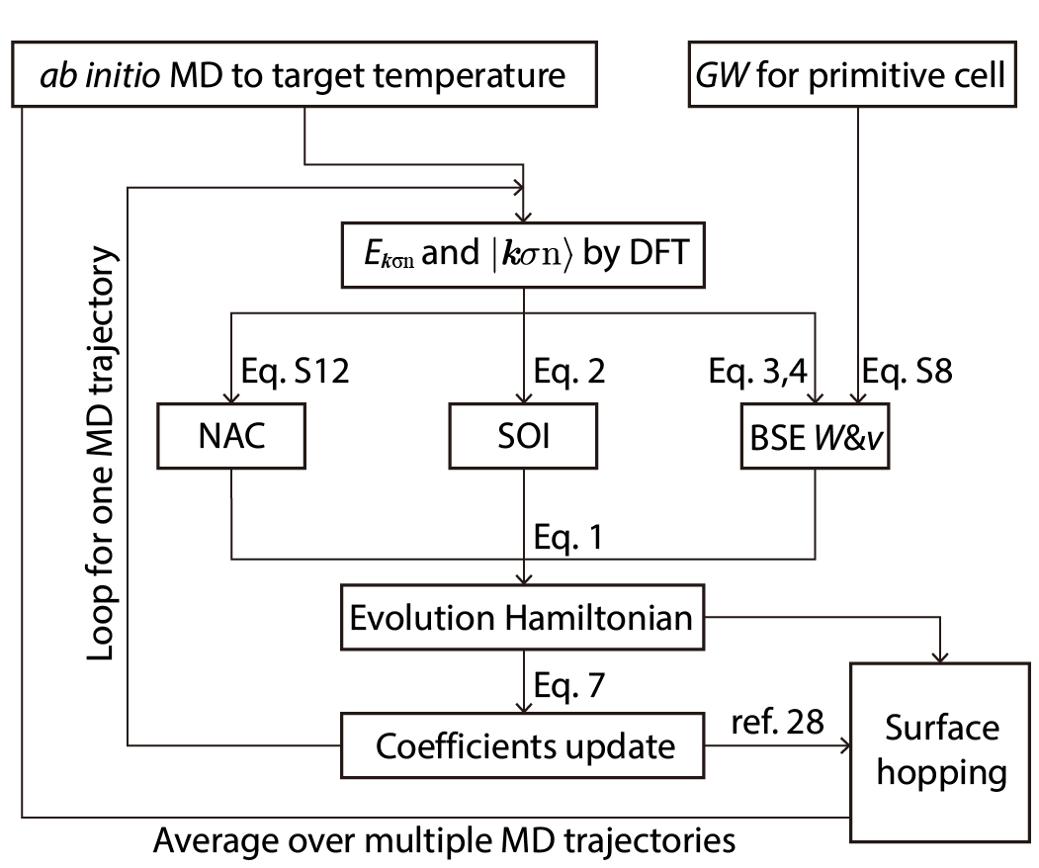
Workflow of Real-Time GW-BSE NAMD

Slide 16
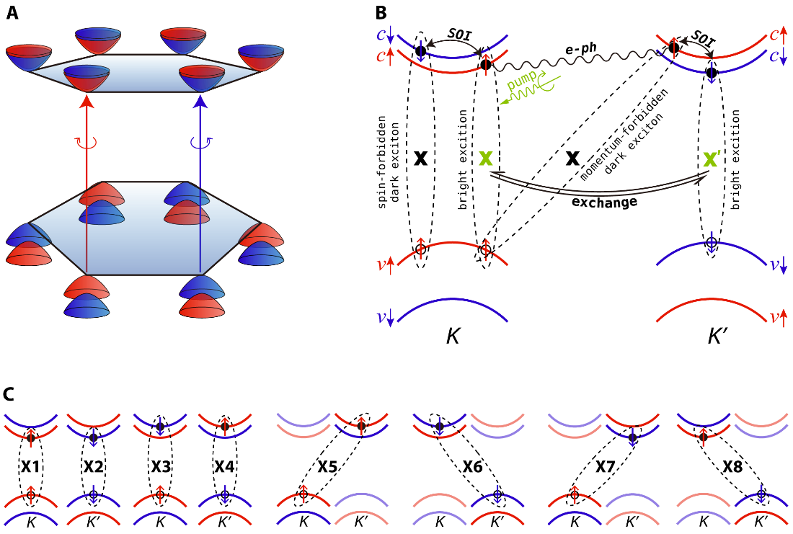
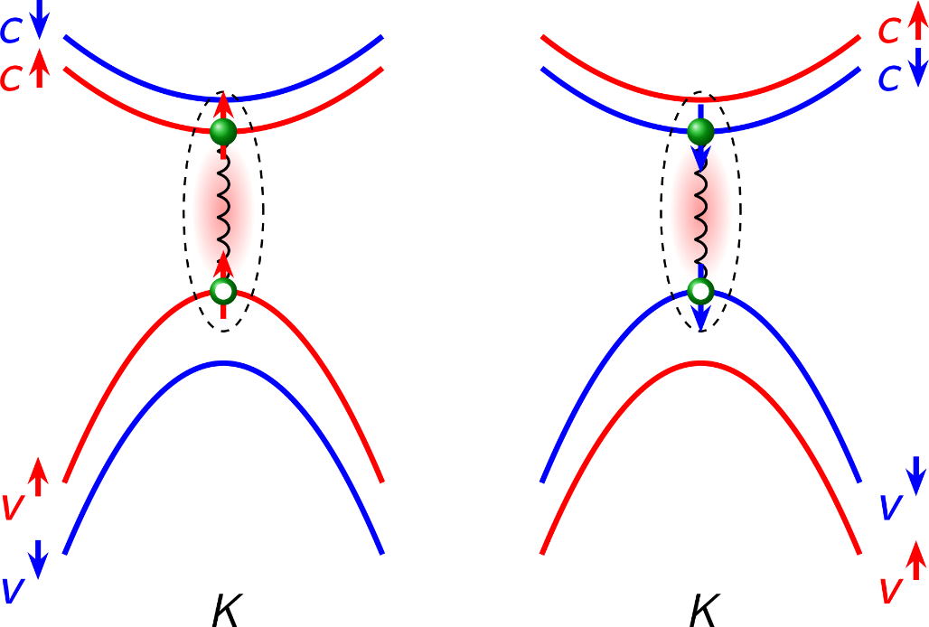
Fast Intervalley Bright Exciton Scattering in Transition Metal Dichalcogenide
< 5 ps
K
K’
K
K’
Intervalley bright exciton scattering requires the spin flip and momentum transition of both electron and hole
Puzzle：how can such intervalley bright exciton happen within several picoseconds？

Slide 17
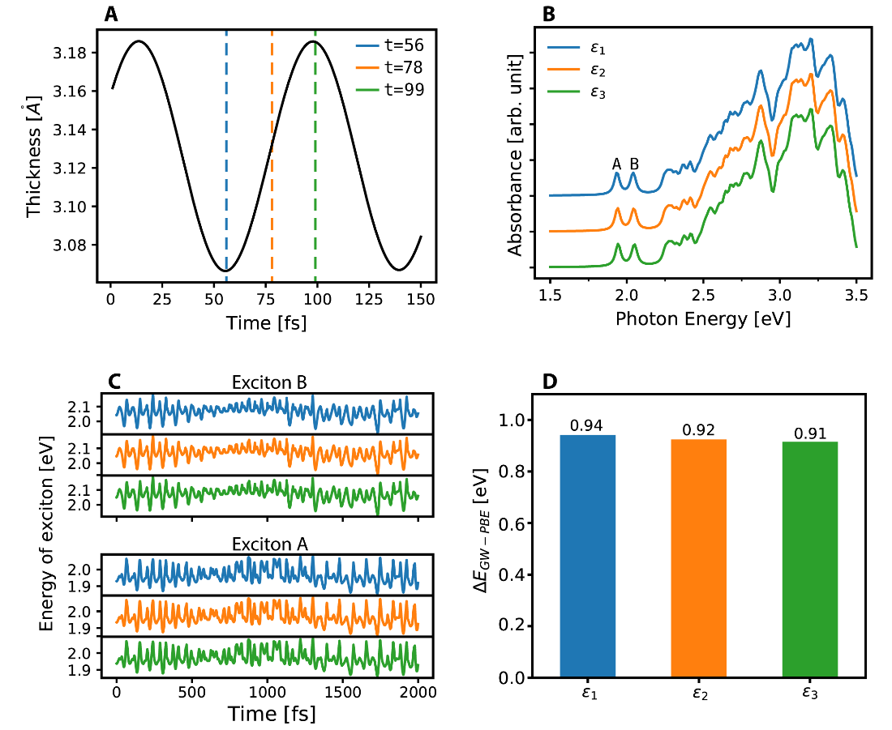
Test of the Dielectric Function Approximation
The dielectric function and GW QP correction almost does not change with the structure

Slide 18
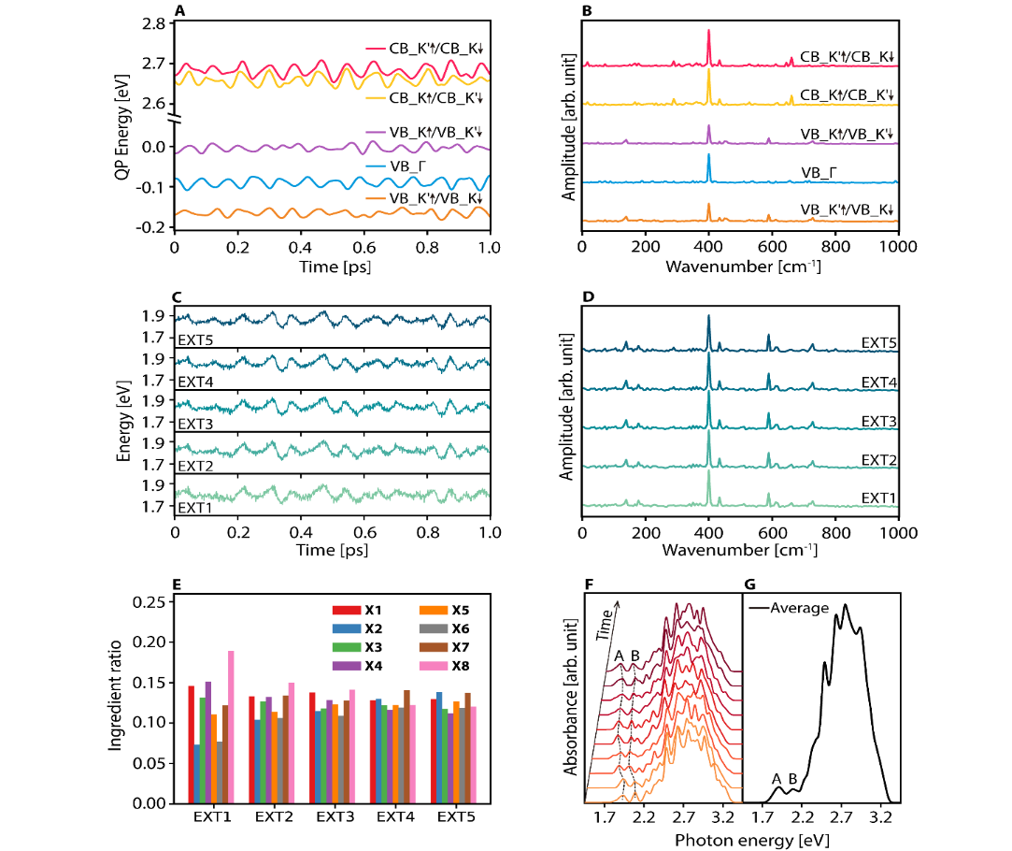
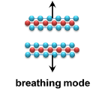

Time Dependent Quasi-Particle Energies and Optical Band Gap of MoS₂
A₁ mode ~400 cm⁻¹
LA mode ~180 cm⁻¹
+
Electron-phonon interaction
A₁ mode ~400 cm⁻¹
LA mode ~180 cm⁻¹
Time-dependent absorption spectrum
Exciton-phonon interaction

Slide 19
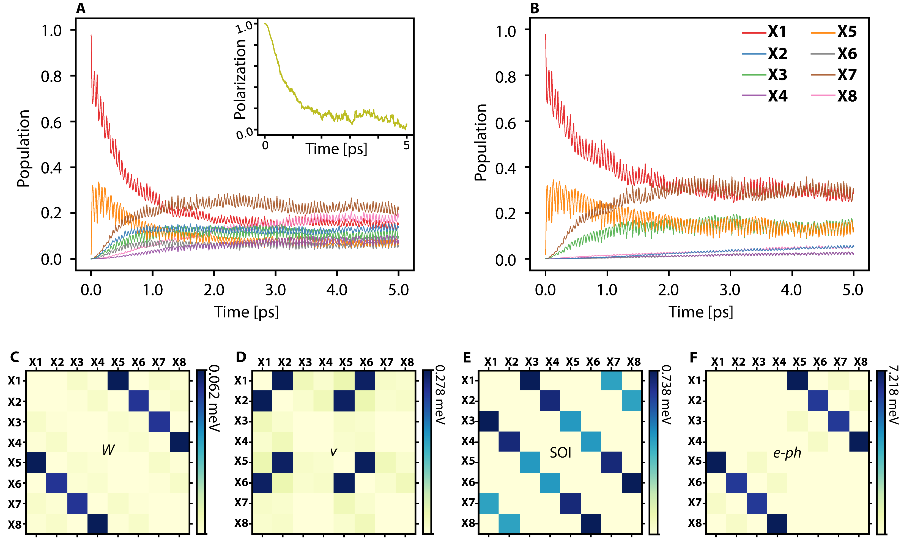
Exciton Dynamics in MoS₂
~40 fs
Bright Exciton transition happens in several ps
~1 ps
~1 ps

Slide 20
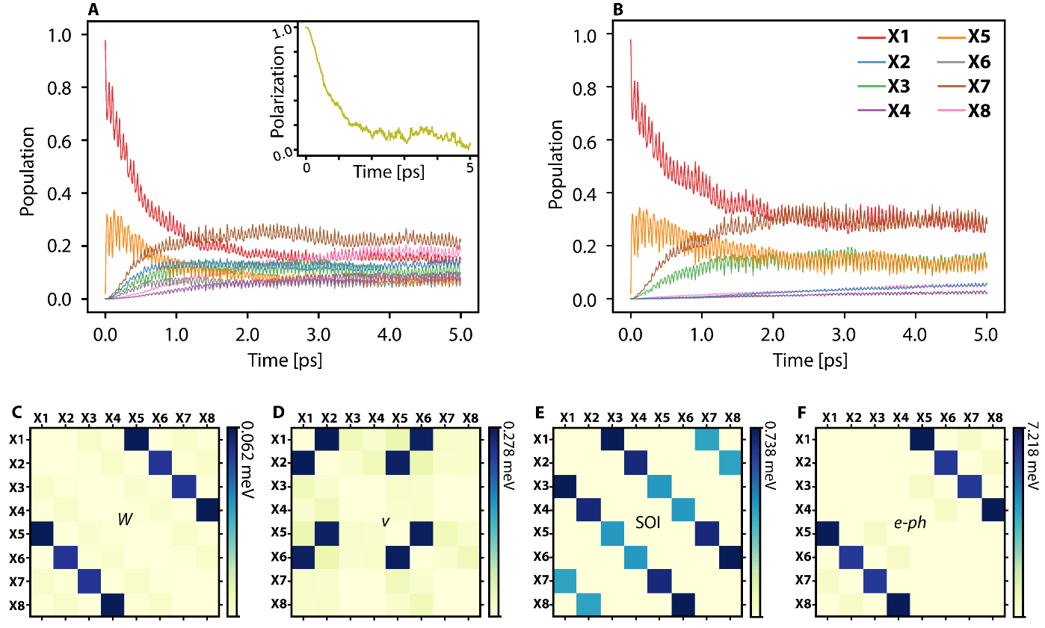
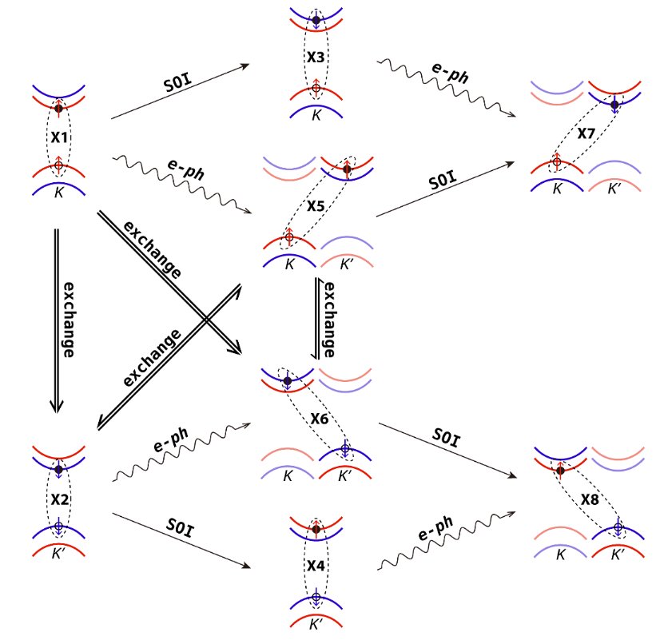
Exchange Interaction Induced Bright Exciton Scattering
Nonadiabatic Coupling Elements：
Single particle dynamics：e-ph
Exciton dynamics: e-ph + W (e-h Coulomb) + v (e-h exchange) + SOC
Bright Exciton transition is induced by e-h exchange interaction

Slide 21
Single Particle Picture
Spin particle picture: photoexcited hole keeps in K valley

Slide 22
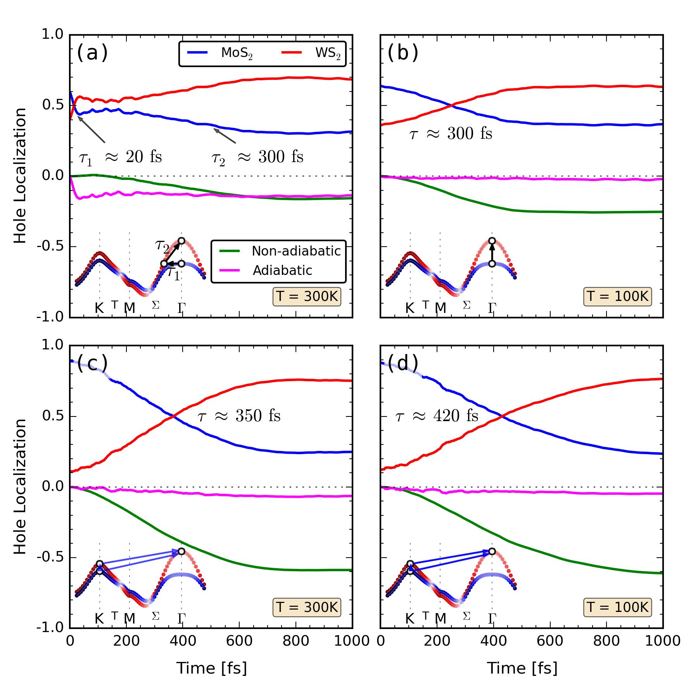
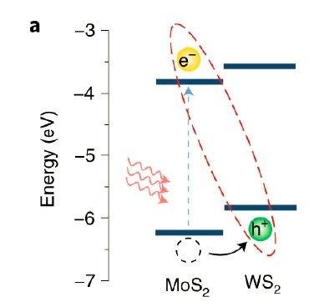
Ultrafast Charge Transfer at TMD Heterostructure
A₁ mode
~400 cm⁻¹
T=83 fs
Q. Zheng, et.al. Nano Lett. 17, 6435-6442 (2017)

Slide 23
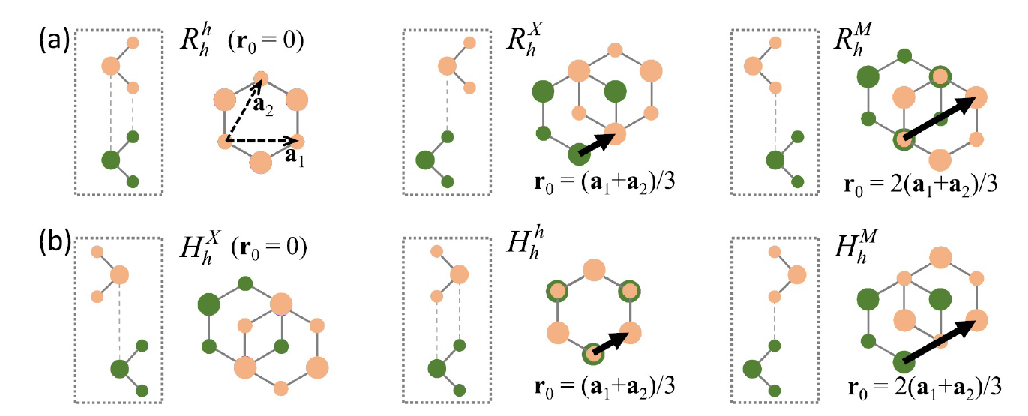
Different Stacking of MoSe₂/WSe₂
×
×

Slide 24
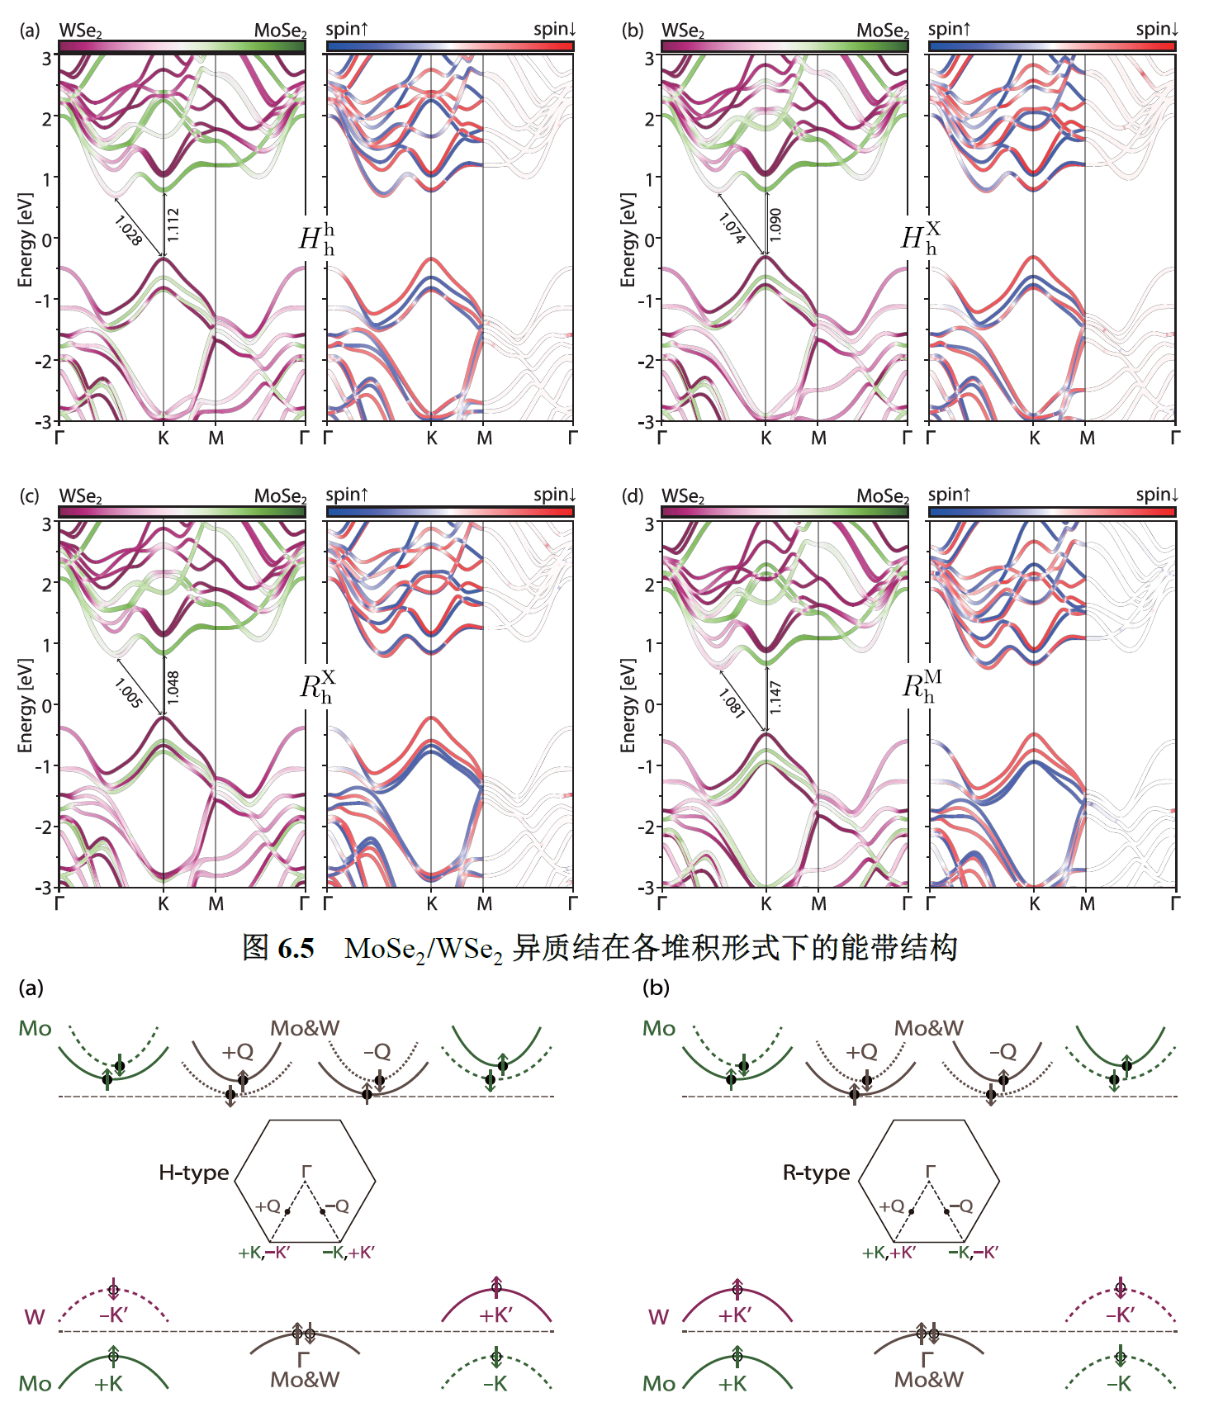
Band Structure of MoSe₂/WSe₂

Slide 25
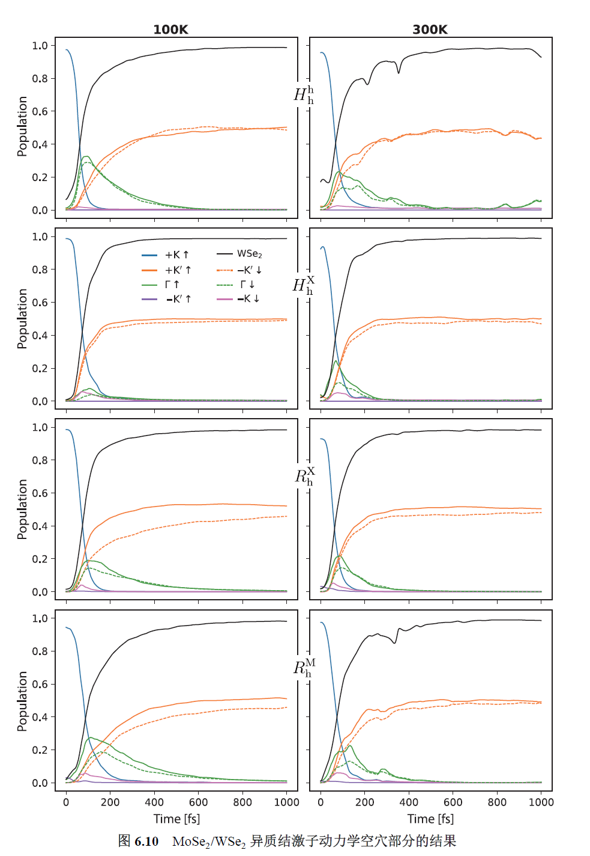
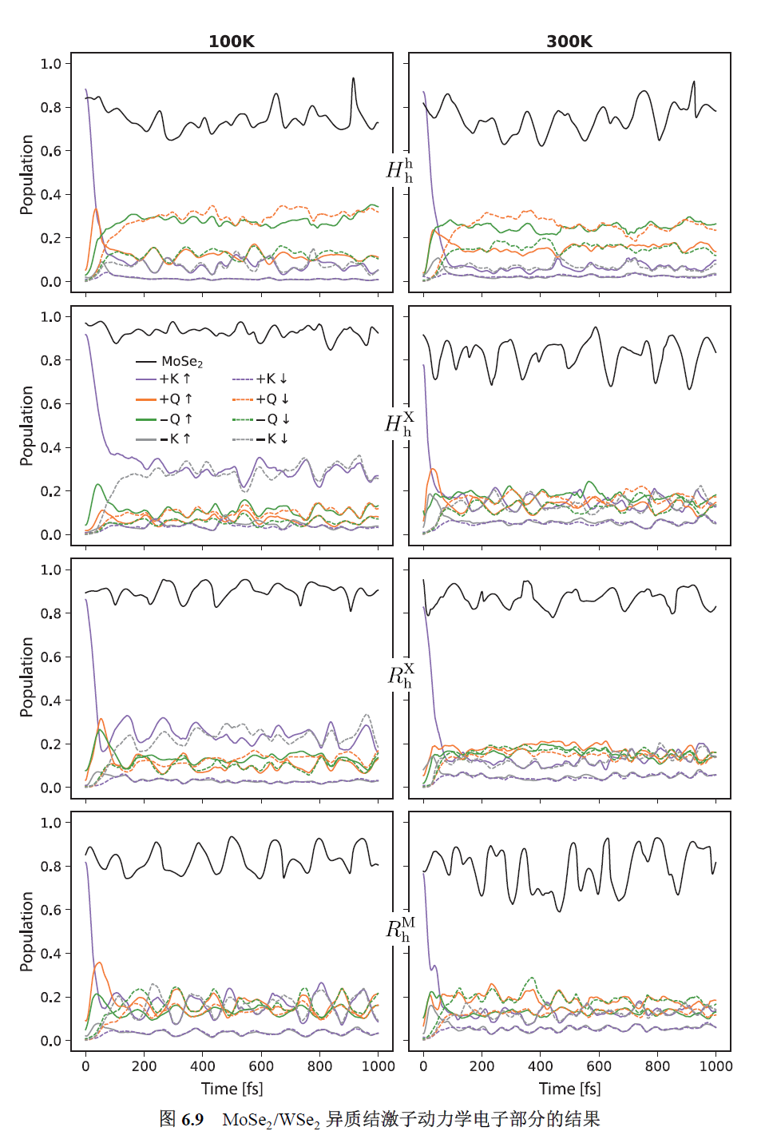
Exciton Dynamics at MoSe₂/WSe₂
100 K
300 K
100 K
300 K
Electron
Hole

Slide 26
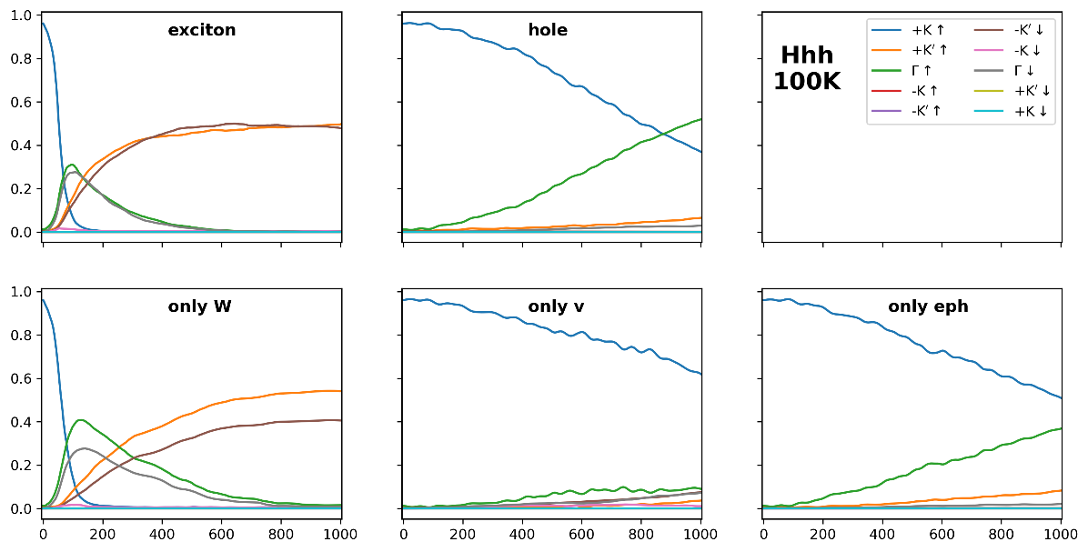
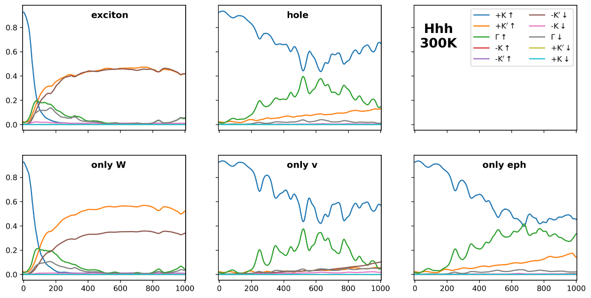
Mechanism of Exciton Dynamics at MoSe₂/WSe₂
E-ph and SOC
Coulomb Interaction (W)
Exchange Interaction (v)

Slide 27
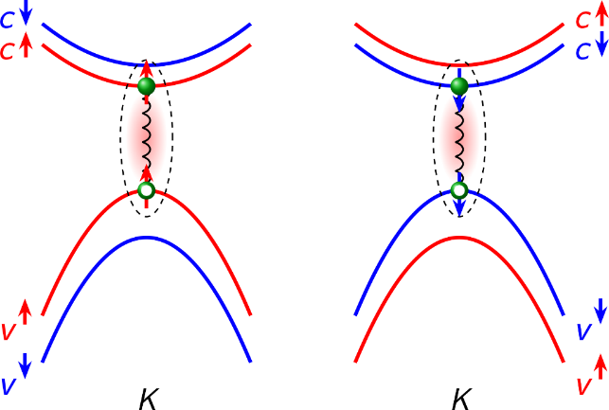



Summary
Single-particle
TDDFT
$$iℏ\frac{∂ψ(r,t)}{∂t}=𝓗\left(r;R\right)ψ\left(r,t\right)$$
Real-time - BSE
$$iℏ\frac{∂ψ(r_{e},r_{h,}t)}{∂t}=𝓗\left(r;R\right)ψ(r_{e},r_{h,}t)$$
two-particle
Many-body interaction
Exciton-phonon interaction
Spin orbital coupling
Nonadiabatic effects
X. Jiang, Q. Zheng, Z. Lan, W. A. Saidi, X. Ren and J. Zhao* Sci. Adv. , 7, eabf3759, (2021)
Xiang Jiang
蒋翔

Slide 28
Future work based on GW + rt-BSE NAMD Simulation
Exciton Lifetime
Hot exciton Relaxation
Exciton transition
at interface
via spin valley
bright-to-dark
…
Exciton-Phonon Interaction
Exciton-Polaron interaction
…
Several thousands of exciton energies from GW + rt-BSE NAMD
Machine learning for excited state potential energy surface
Photocatalysis

Slide 29
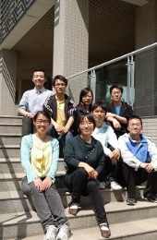


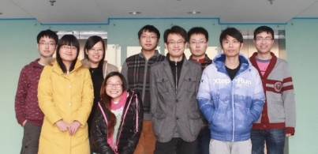
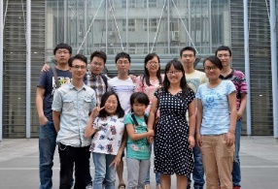
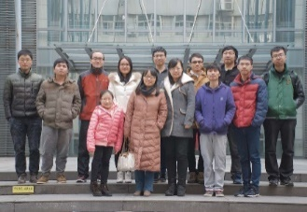
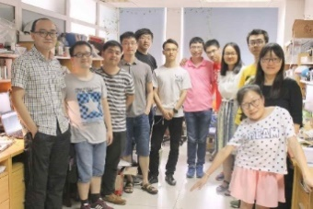


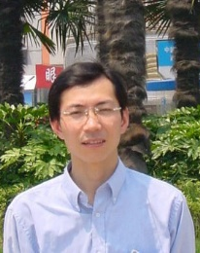
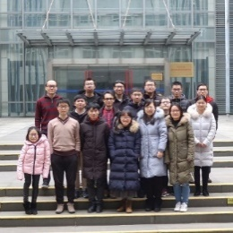
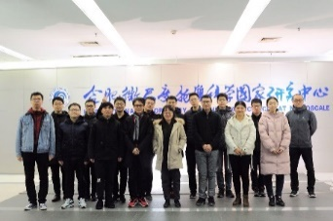
Acknowledgement
2011
2013
2015
Zhenggang Lan
兰峥岗
Wissam A. Saidi
U. Pitt
DFT calculations
South China Normal University
Surface hopping
2016
2017
Xingguo Ren
任新国
Hrvoje Petek
Jinlong Yang
杨金龙
U. Pitt
Experiments
USTC
Ph.D advisor
Discussion & support
USTC
GW+BSE
2019
2020
My Group
Collaborators

